Slide 1
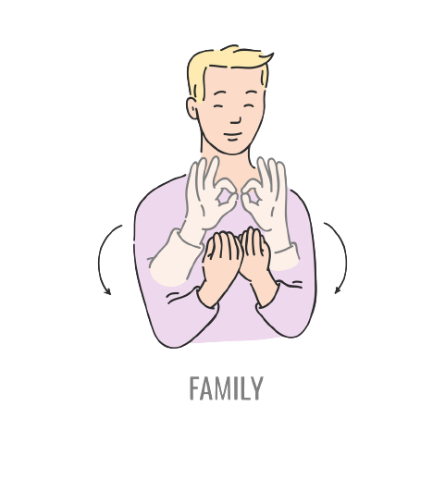
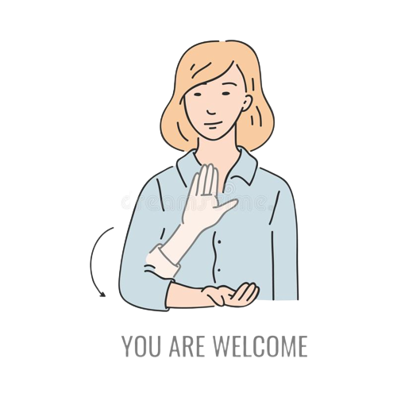
Conversion of Sign Language to text

Slide 2

Team Members
Naman Shrimal
Priyal Saini
Syed Israr Hussain
Urjasvi Kurakula
21BTRCL069
21BTRCL080
21BTRCL109
21BTRCL115

Slide 3
TABLE OF CONTENTS
01
Introduction
02
Literature Review
03
Objective
04
Problem & Motivation
05
Existing Methodology
06
Proposed Model

Slide 4
Introduction
This study and thesis explore the possibility of using artificial intelligence to enhance hearing and deaf people's communication. Like all other sign languages, Flemish sign language has its own vocabulary and syntax and is recognised by the government. Moreover, about 6000 Flemish people speak it as their mother tongue.
However, since so few people in the world are normally able to understand sign language, it can be challenging for hearing and deaf people to hold even basic conversations. In this way, the research tackles a problem that is extremely current and for which technology, like artificial intelligence, may be able to provide (part of) a solution.

Slide 5
Literature Review
1. Glove Based System
Sensors such as potentiometer, accelerometers etc. are attached to each of the ﬁngers.
Based on their readings the corresponding alphabet is displayed.
The main problem faced by this gloved based system is that it has to be recallibrated every time whenever a new user on the ﬁngertips so that the ﬁngertips are identiﬁed by the Image Processing unit.
2. FingerSpelling
A technique in which the signer signs a word by using individual signs for each letter.
Can be used for short conversations and simple gesture.
It is impractical for daily communication.

Slide 6
Literature Review
Hand Gesture Recognition for Sign Language Recognition: A Review in: Authors presented various method of hand gesture and sign language recognition proposed in the past by various researchers. For deaf and dumb people, Sign language is the only way of communication. With the help of sign language, these physical impaired people express their emotions and thoughts to other.
Offline Signature Verification Using Surf Feature Extraction and Neural Networks Approach [6]:
In this paper, an off-line neural network-based method for signature detection and verification is proposed, in which the user is shown a recorded image of the user's signature.

Slide 7
Literature Review
R.Agarwal, Sumeet & Agrawal, Sagarkumar & Latif, Akhtar, presents the development of an application which will enable a hassle free communication between physically disabled person and normal person. In this approach, gestures based on Indian sign language are used. The major stapeps associated with the application are gesture recognition and natural language processing as most important module.
Stone, Matthew and Christine Doran, present a Lexicalized Tree Adjoining Grammar algorithm for simultaneously building both the syntax and semantics of a sentence (LTAG). This method captures the connection between pragmatic and syntactic constraints on descriptions in a sentence, as well as the inferential interactions between several descriptions in a sentence, in a natural and beautiful manner.
Ishola, Ọlájídé, discusses what a language at its core, how grammar is different from past till present and NLP intersection for language with computers and with the help of concise grammar rules, machines can process human languages.

Slide 8



Objective
The Sign Language Recognition System is a real-time vision based system whose purpose is to recognize the sign language.
Aims to bridge the gap between speech-impaired and normal people.
Provide an eﬃcient and accurate way to convert sign language to text
Identifying alphabets, digits and words.
Classiﬁcation of hand gestures using computer vision and machine learning algorithms

Slide 9
Problem
People with the inability to speak, use sign language for communication. Ordinary people usually ﬁnd it very diﬃcult to communicate with mute people due to their lack of understanding of the sign language.
An interpreter won’t be always available and visual communication is mostly diﬃcult to understand. Sign Language is the primary means of communication in the deaf and dumb community. As a normal person is unaware of the grammar or meaning of various gestures that are part of a sign language, it is primarily limited to their families and/or deaf and dumb community.

Slide 10
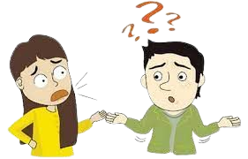
Motivation
Sign language is used by speech impaired people to communicate
This language is only known to other speech impaired and family members
Diﬃcult to use this language with others

Slide 11

Existing Methodology

Slide 12
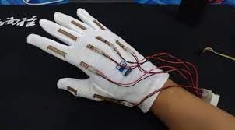
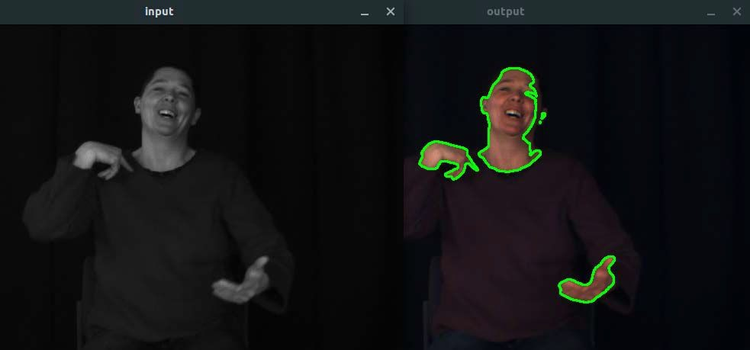
Technology Evolution
Sign language translation machine
Sensor based sign language recognition
Vision-based sign language recognition

Slide 13

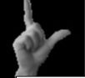

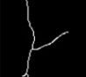

Processing, Detection & Classiﬁcation
Frame after Down-Sampling Converting image to Grayscale Contour Masking of hand gesture
Threshold Contouring is performed to segment the hand image from the background.
Threshold masking is used to exclude unnecessary from image processing
Contours deﬁned as a curve that connects all the continuous points (along the boundary),
Skeletonization [4] is a method for reducing foreground regions to a skeletal.
Applying Gaussian ﬁlter, doubling the threshold to detect possible edges, calculating intensity gradient are the steps performed while applying Canny Edge method.
Skeleton form of the image
Canny Edges form of the image

Slide 14

Proposed Model

Slide 15
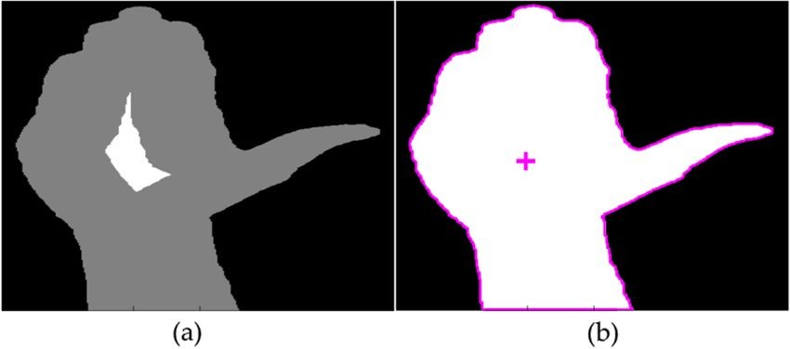
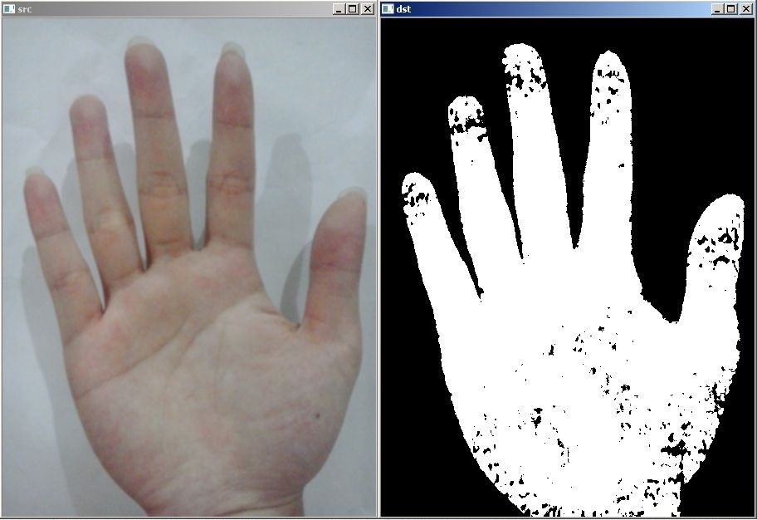
Preprocessing and Segmentation
Eliminate unwanted noise and enhance the quality of the image
Segment and extract the region of interest from the entire image
Thresholding, Background subtraction, skin-based and motion based segmentation
Feature Extraction
Method of reducing data dimensionality
Transforms the input image region into feature vectors for recognition
Centroid and skin colour

Slide 16
Gesture Classification
The strategy that we employed for this project is:
Our method predicts the user's final symbol using two levels of algorithm.
First Algorithm Layer:
After feature extraction, process the frame from an open camera with a gaussian blur filter and threshold to produce the final image.
Second algorithm layer:
We detect various sets of symbols which show similar results on getting detected. We then classify between those sets using classifiers made for those sets only.

Slide 17
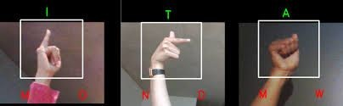
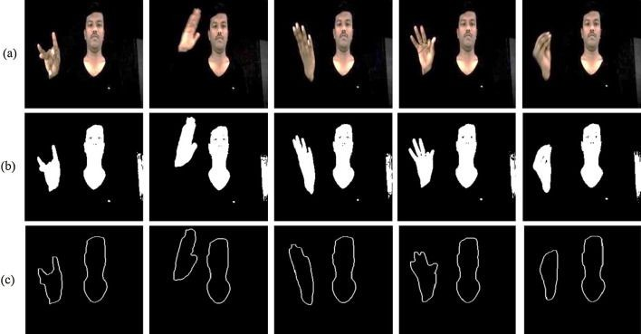
Query Image Classiﬁcation
GrayScale and Binary Image
Query Image
Feature Detection and Extraction
Deﬁning the ROI
Classiﬁcation using KNN
Conversion to
text/speech

Slide 18
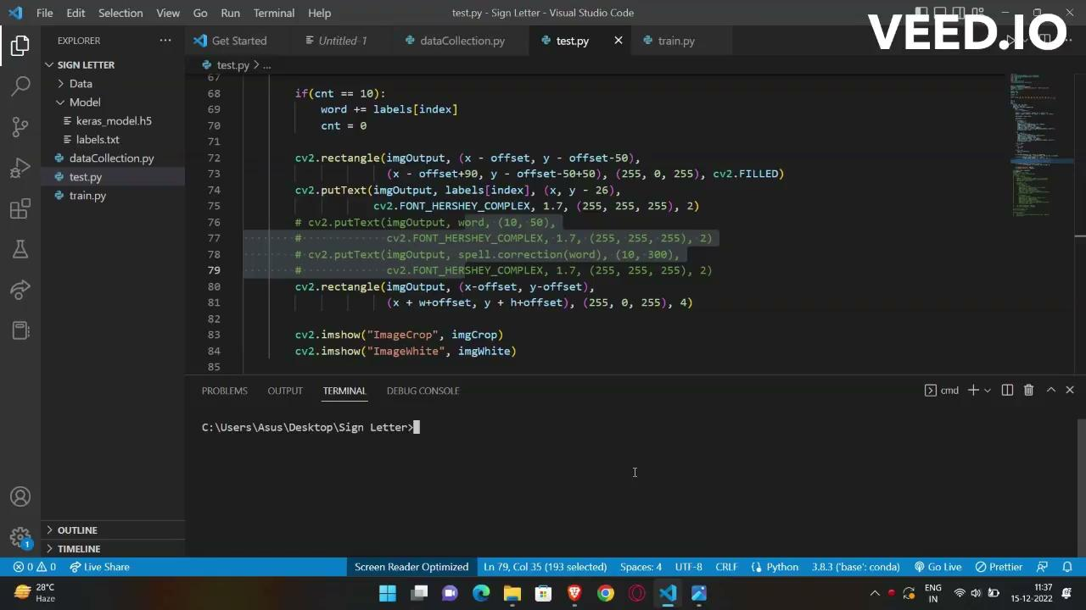
Phase 0- Letter Recognition

Slide 19
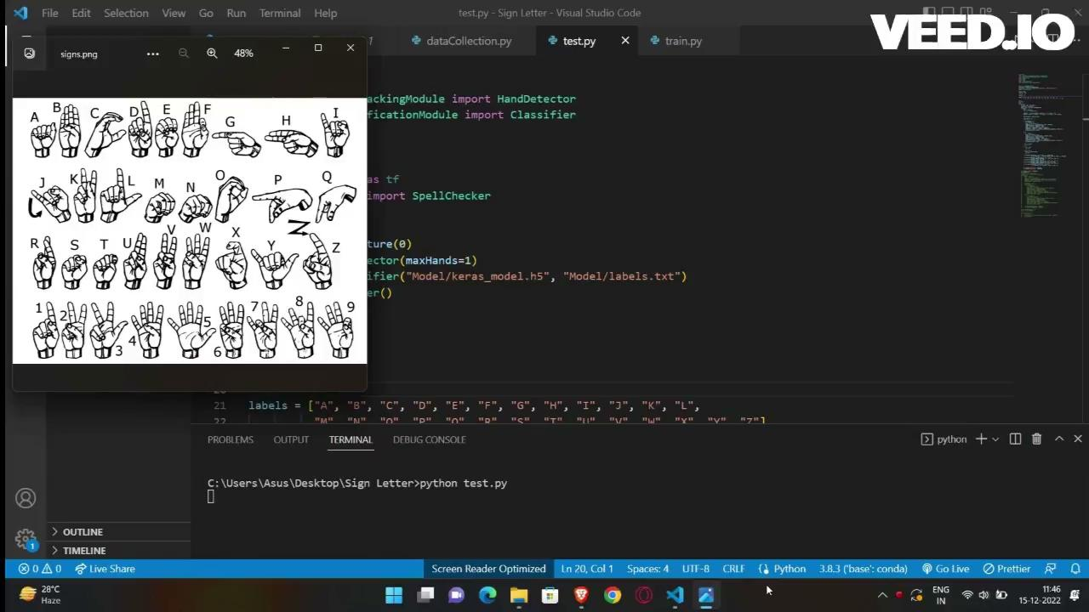
Phase 1- Letter to Word Formation

Slide 20
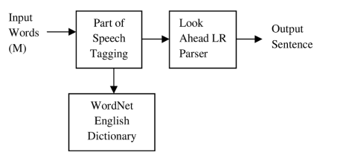
Phase 2- Sentence Formation

Slide 21
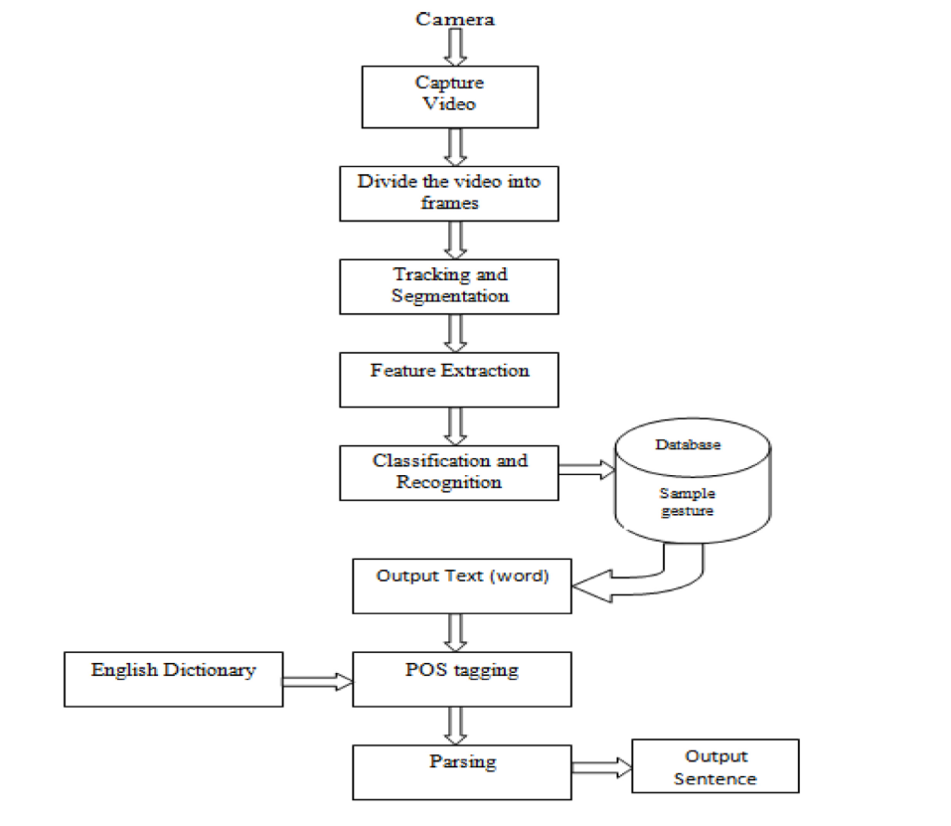
Flow Chart
Phase 0 and 1
Phase 2

Slide 22
Why NLP?
English
Language
American Sign
Language
Subject-Verb-Object
Topic Comments Structure
ADD PROPER SYNTAX AND FILL THE STOP WORDS

Slide 23
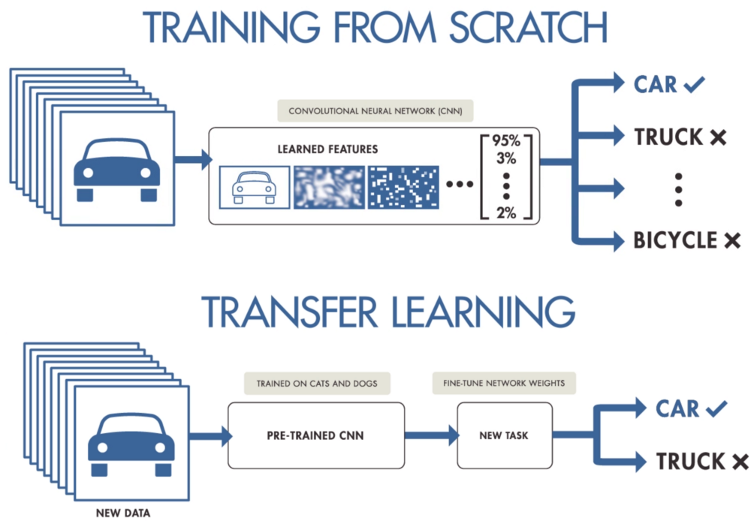
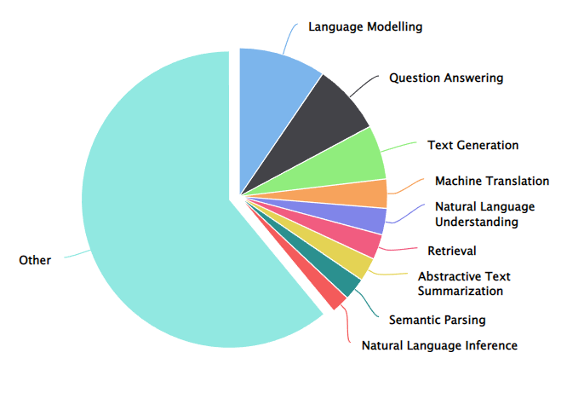
Transfer Learning
T5 (Text-to-Text Transfer Transformer)
Language model developed by Google's research team
Pre-trained on a massive amount of text data
Fine-tuned on a specific task with few training examples
T5 fine-tuned on CommonGen for Generative Commonsense
Constrained text generation task
Test machines for the ability of generative commonsense reasoning
Given a set of common concepts, generate a coherent sentence
Consists of 30k concept-sets and 50k sentences in total.
Given concept-set: dog, frisbee, catch, throw
T5: Dog catches a frisbee and throws it to a dog
Human Sentence: A dog leaps to catch a thrown frisbee

Slide 24
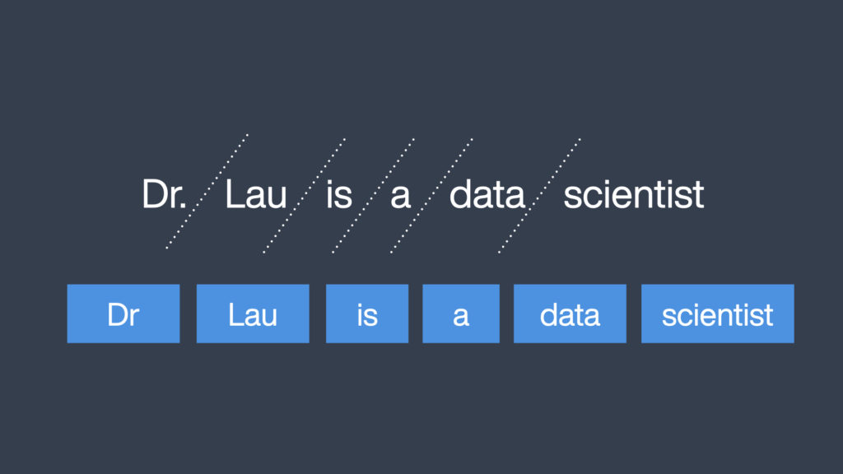
Tokenization

Slide 25
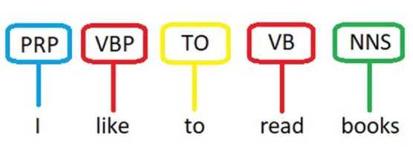
POS Tagging
The words obtain from phase I passed to NLP. The tag may indicate one of the parts-of-speech tag like:-
noun (N)
preposition (Prep)
pronoun
adjective (Adj)
verb (V)
adverb (Adv)
conjunction
interjection

Slide 26
POS Tagging Algorithm
Take I as input and mentioned list of POS tags such as Noun, Verb, Adjective, Adverb, Preposition.
Find the words for mentioned tags in the training data corpus.
Calculate the probability of tags for every words in given data corpus are as follows:
P (ta | iw) = c (iw, ta)/ (c (iw, t1) + … + c (iw, tn))
where iw = input word M, ta = tag for input word I, c (iw, ta) is number of times appear in corpus.
Tag with parts of speech to the word occur with maximum probability.

Slide 27
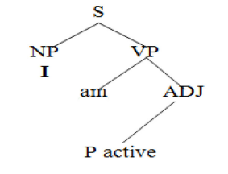
Grammar Design
To construct a valid sentence we require a set of rules of the particular language.
The simplest and easiest form of grammar is context free grammar (CFG)
G = {V, T, P, S}
Where,
V = final set of non-terminal symbols
T = final set of terminal symbols
P = set of production rules
S = the start symbol
In CFG, the structure of a sentence can be represented in the form of a tree diagram,
where each node represents a constituent and each edge represents a relationship
between the constituents.
CFG does not take into account the meaning or context of the sentence.

Slide 28
LTAG
LTAG extends the basic CFG model by incorporating constraints from syntax, semantics, and pragmatics.
LTAG
Syntax
Pragmatics
Semantics

Slide 29
LALR PARSING
The LALR parser operates on a context-free grammar (CFG) and uses a bottom-up parsing approach to construct a parse tree for the given input sentence.
The LALR parser works by maintaining a stack of states and symbols, and repeatedly applying shift and reduce operations to the input symbols, based on the current state and look-ahead symbol.
Stop words and articles are not included in the sign language we will be
inserting them into appropriate places using the lexical grammar tree for constructing a meaningful sentence.

Slide 30
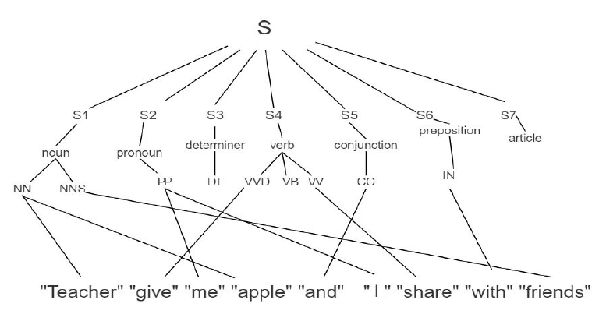
LALR PARSING

Slide 31
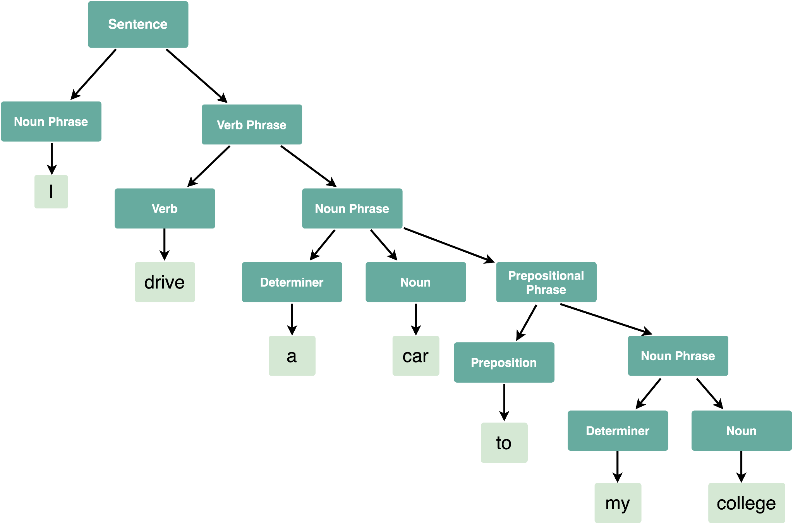
LALR PARSING

Slide 32
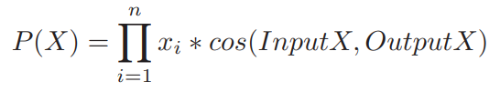
Grammar Correction
The grammar is checked using Bidirectional Encoder Representations from Transformers (BERT) which is used on the data set of Lang-8 Corpus of Learner English.
A multi-headed language model is generated that uses BERT as encoder and decoder Transformer for grammar correction (excluding spelling correction) with Replace and Range Heads options.
The Transformer is bidirectional and helps in understanding the context of the sentence.
The multi-headed BERT gives a suggested correction. The correction is stored in final results along with probability which is given as:

Slide 33


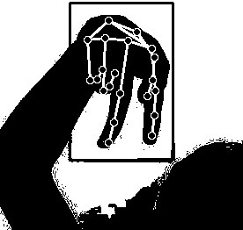
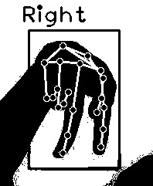
Workflow
Walk
Output Sentence
NLP Model

Slide 34
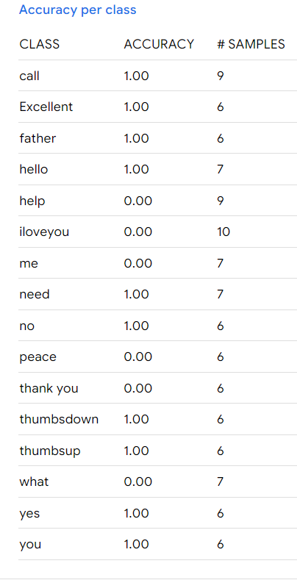
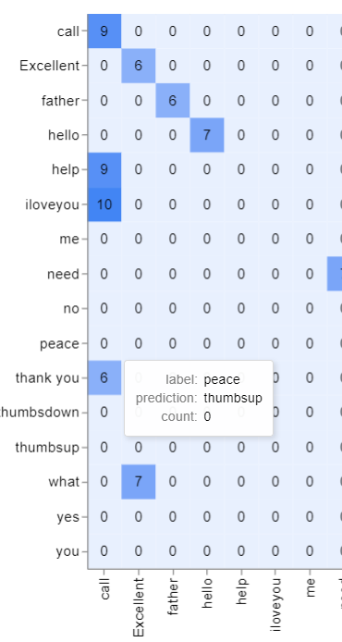
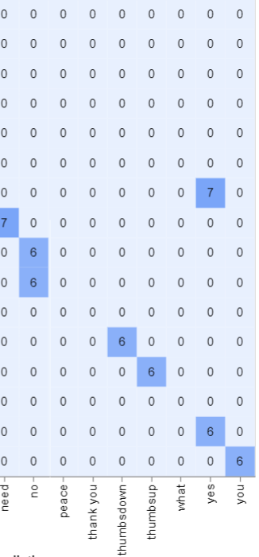
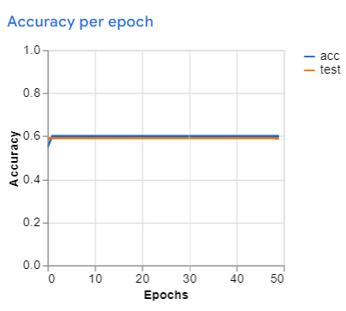
Classification Report

Slide 35
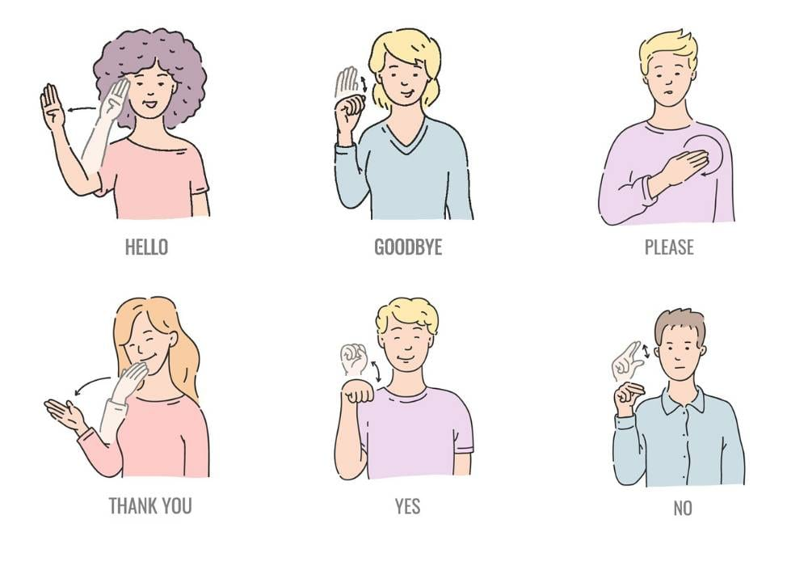
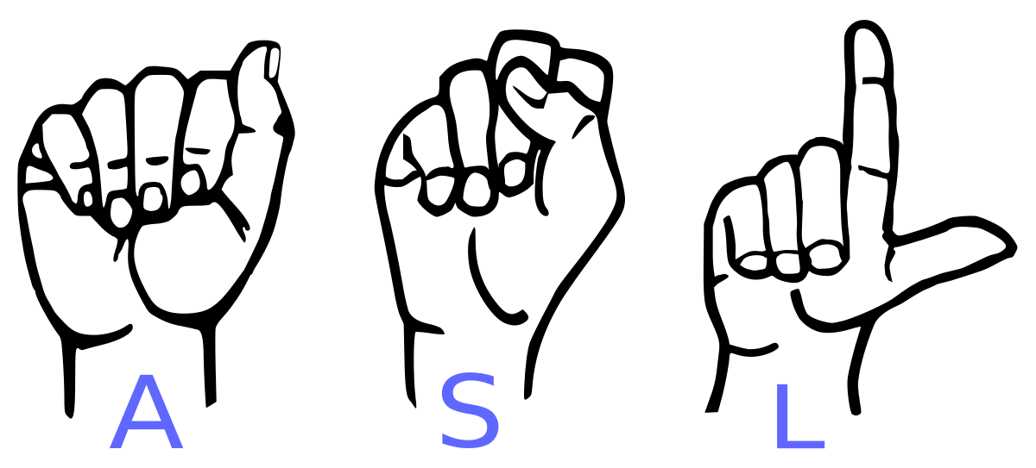
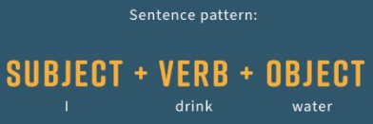
Modules
Letter - Based Recognition
Word - Based Recognition
Sentence Formation

Slide 36
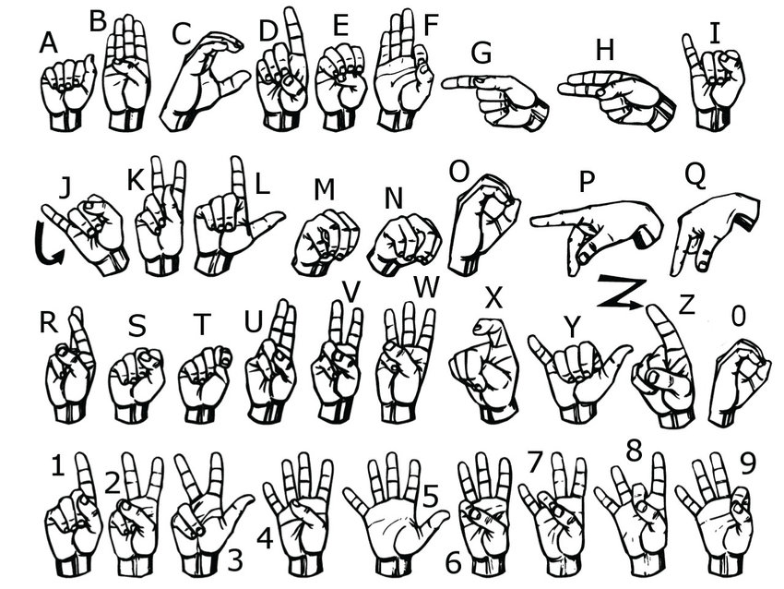
Letter Based Recognition

Slide 37
Data Capturing and Preprocessing
Feature Marking
Capture video from device webcam
Used OpenCV to extract the frames
Identified the hand using Hand Tracking Module
Crop the hand area
Identify the features of the hand
Includes fingertips and joints
Considers the orientation of the marked points

Slide 38
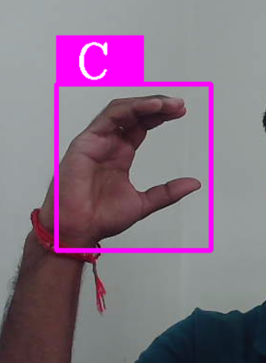
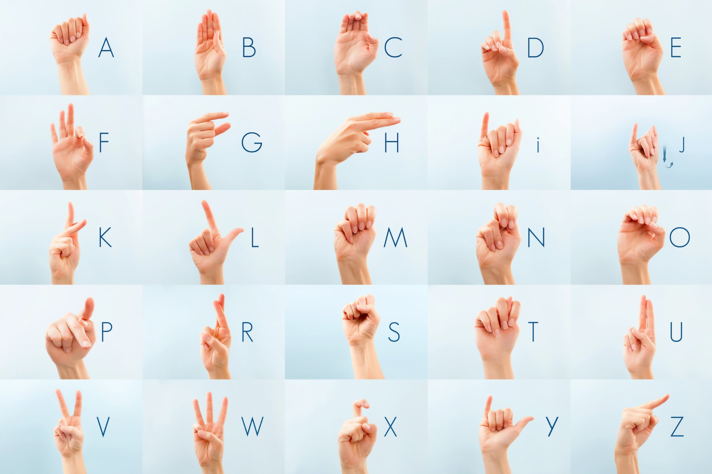
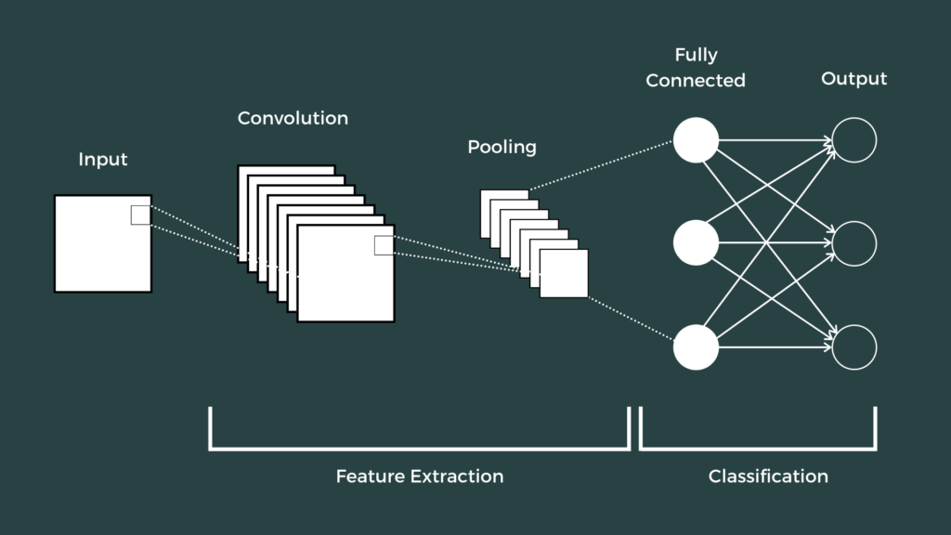
Sub - Modules
Data Collection.py
Train.py
Recognize.py

Slide 39
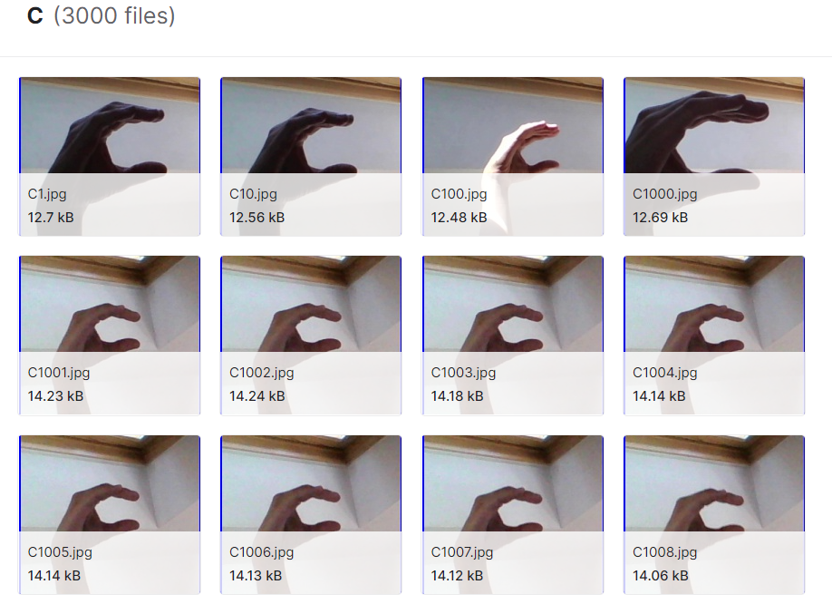
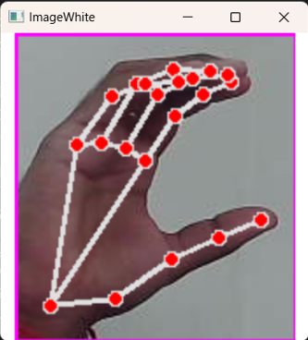
Data Collection
ASL Alphabet is used as dataset in our model.
CNN algorithm is applied
Hand Tracking Module is used to map the features
Ability to add custom letters
For custom letters, create images data and use it for training.

Slide 40
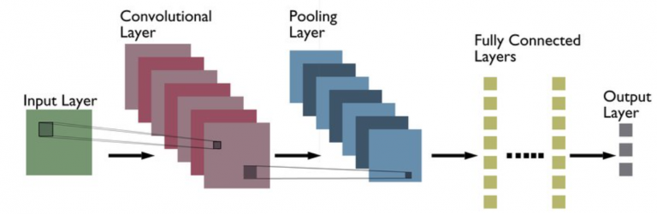
Why CNN?
Effective in reducing the number of parameters
Retains the 2D spatial form of images.
Scanning the complete feature matrix and carry out the dimensionality reduction

Slide 41
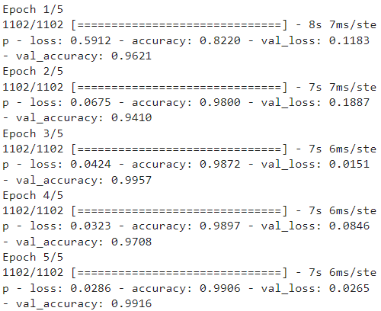
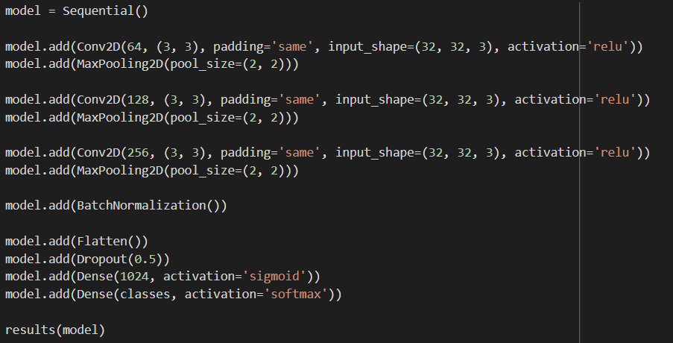
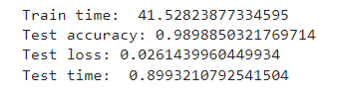
3 Layer CNN
Epochs Result:
3 Layer CNN Code:
Accuracy:

Slide 42
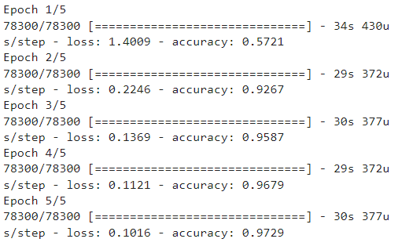
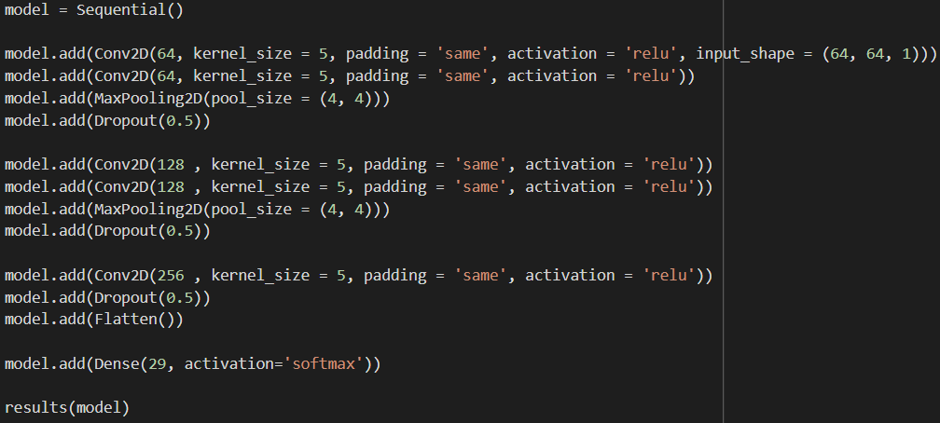
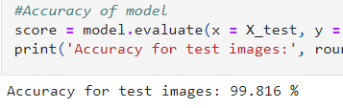
5 Layer CNN
Epochs Result:
5 Layer CNN Code:
Accuracy:

Slide 43
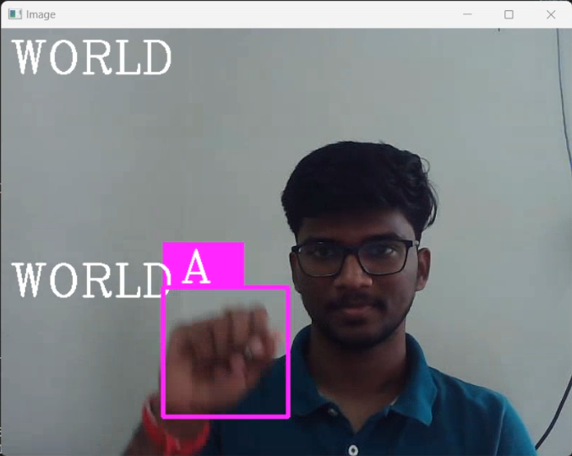
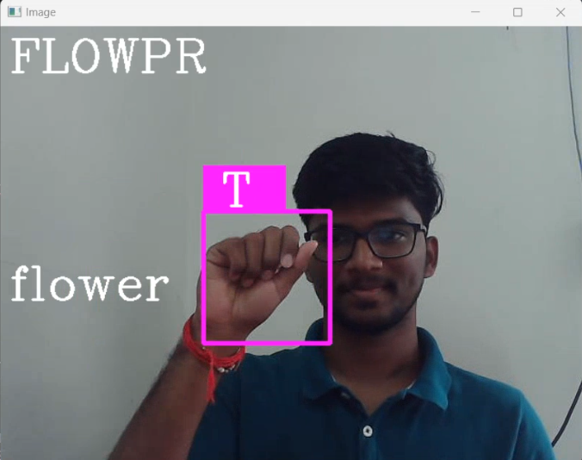
Words from Letters
Auto-Correct
Carousel of Images
Setting interval where the program continuously recognizes the same letter
Add letter to the word
Added sign for backspace
Corrects words with wrong classification of letter
Corrected using Levenshtein Distance algorithm through PySpellChecker

Slide 44
Used Methodology
T5 (Text-to-Text Transfer Transformer)
Language model developed by Google's research team
Pre-trained on a massive amount of text data
Fine-tuned on a specific task with few training examples
T5 fine-tuned on CommonGen for Generative Commonsense
Constrained text generation task
Test machines for the ability of generative commonsense reasoning
Given a set of common concepts, generate a coherent sentence
Consists of 30k concept-sets and 50k sentences in total.
Given concept-set: dog, frisbee, catch, throw
T5: Dog catches a frisbee and throws it to a dog
Human Sentence: A dog leaps to catch a thrown frisbee

Slide 45
Word Based Recognition

Slide 46
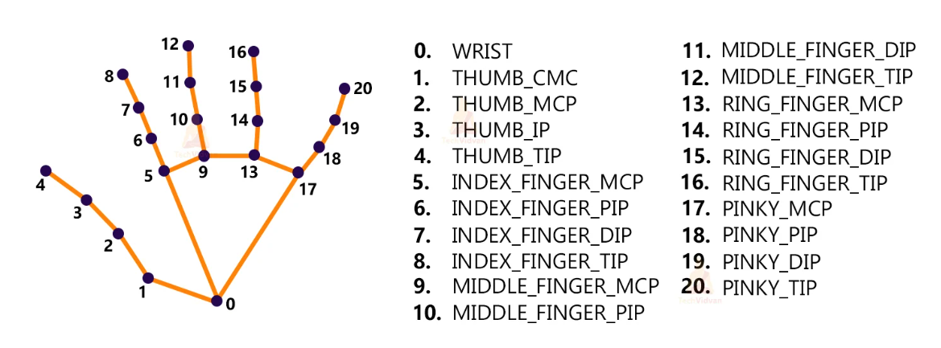
FEATURE EXTRACTION
Open-CV Zone

Slide 47
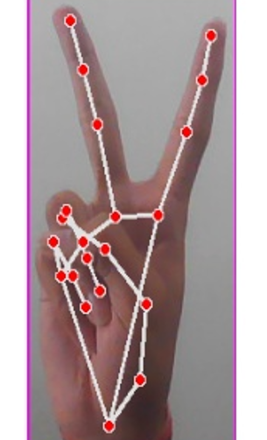
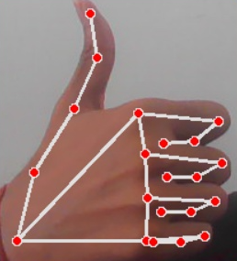

Word Based : Creating Our Dataset

Slide 48
Classification Report

Slide 49

Word Based : A Challenge
Difficult to classify dynamic gestures (Gestures including motion)
Need All the frames of video to train a network
and not just a single frame.
With the model that we have built it is difficult
to apply it to the given data set videos as
feature extraction of the hands is important.
Sign for Fire

Slide 50



Word Based : A Challenge
Gestures differ by the position of gesture with respect to the body
Ambiguity between multiple words having same/similar gesture

Slide 51
Preparing Dataset
After collecting all the resources for the dataset, if the gloss annotations are composed of more than two words in English, we will remove those videos to ensure that the
dataset contains words only.
If the number of the videos for one gloss is less than seven, we also remove that gloss to guarantee that enough samples are split into the training and testing sets
Since most of the websites include daily used words, the small number of video samples for one gloss may imply those words are not frequently used. Therefore, removing those glosses with few video samples will not affect the usefulness of our dataset in practice
In the training phase, we randomly select at most 50 consecutive frames from each video

Slide 52
Pose Based Baselines
Human pose estimation aims at localizing the key points or joints of human bodies from a single image or videos.
The Traditional approaches employ the probabilistic graphical model or pictorial structures to estimate single person poses. Recently, deep learning techniques have boosted the performance of pose estimation significantly.
Pose estimation only provides the locations of the body keypoints., while the spatial dependencies among the estimated keypoints are not explored. Pose based RNN’s explore the locations of body joints as a feature representation for recognition.

Slide 53


Pose Based
RNN
Pose based approaches mainly utilize RNNs to model the pose sequences for analyzing human motions.
Pose Based Temporal GNN
We view a human body as a fully-connected graph
with K vertices and represent the edges in the graph as a
weighted adjacency matrix
Pose Based RNN
(b) Pose Based Temporal RNN

Slide 54

Sentence Formation

Slide 55
Code Snippet:
import cv2
# Open the camera
cap = cv2.VideoCapture(0)
import cv2
import numpy as np
import os
# Define the lower and upper boundaries of the skin color in HSV
skin_lower = np.array([0, 20, 70], dtype=np.uint8)
skin_upper = np.array([20, 255, 255], dtype=np.uint8)

Slide 56
Research Gaps
Training and testing the model on a limited dataset. This makes the model suitable for only a certain kind of operations.
Unavailability of working model of sentence formation
Image-to-text approach: Sentences are formed by taking the image as input and produces text as output. Rather we use a text-to-text approach reducing complexity and increasing efficiency.
Not restricting the domain of the model: Shows different kinds of random output sentences from the given set of words.

Slide 57
References
Sumeet R. Agarwal, Sagarkumar B. Agrawal, Akhtar M. Latif,“Sentence Formation in NLP Engine on the Basis of Indian Sign Language using Hand Gestures”, International Journal of Computer Applications (0975–8887) Volume 116 – No. 17, April 2015.
Xiujuan Chai, Hanjie Wang, Fang Yin, Xilin Chen, “Communication tool for the hard of hearings: A large vocabulary sign language recognition system”, International Conference on Affective Computing and Intelligent Interaction (ACII), IEEE, 2015
Sentence Formation Using NLP on the Basis of American Sign Language Kevin Gajjar1, Aman Agrawal , Arran Gonsalves3, Gargi Singh -2022
Indian Sign Language Interpretation and Sentence Formation by Disha Gangadia, Varsha Chamaria, Vidhi Doshi, Jigyasa Gandhi - 2020.

Slide 58

Future Work
Increasing the dataset. We aim at increasing the dataset of words.
Handle Dynamic Gestures more efficiently.
Implementing a text to sign language application for two way communication.

Slide 59
Thank You!

